Slide 1
A REGRESSION analysis on GDP-per-capita in 4000 cities in brazil
Regression
By Chau Hoang
Spring 2020

Slide 2
About
- Source: mainly from Brazilian Institute of Geography and Statistics (IBGE)
- Total: k = 81 variables and n = 5573 observations
- This analysis: k = 59 ( p = 58, y = GDP_CAPITA ), n = 4000
- Four different regression models including Ridge Regression (RD), Lasso (LS), Elastic Net (EN) and Random Forest (RF) are implemented and evaluated on split dataset and bootstrap samples.
- Data dictionary, R code and data file can be found here.
Notes:
The original dataset comprehensively comprises of data from many sources, mainly from Brazilian Institute of Geography and Statistics (IBGE). The data has information from Resident Population to Gross Domestic Product of 5573 cities in Brazil, which is publicly available and put together on Kaggle.
There are 81 variables and 5573 observations in total; however, due to the missing data points, a subset of this data is used in this analysis (k = 59 variables, n = 4000 observations).
In order to study the relationship and build predictive models on GDP-per-capita (a response variable) based on p = 58 predictors, four different regression methods including Ridge Regression (RD) , Lasso (LS), Elastic Net (EN) and Random Forest (RF) are implemented and evaluated

Slide 3
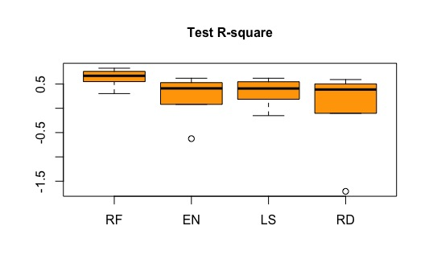
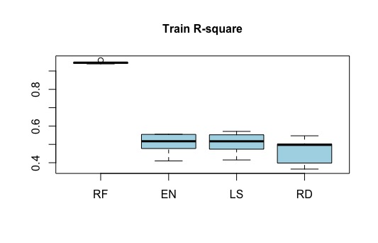
Models evaluation using r-square on test and train set
Notes:
How much variance is explained by the model. Ran the loop 5 times

Slide 4
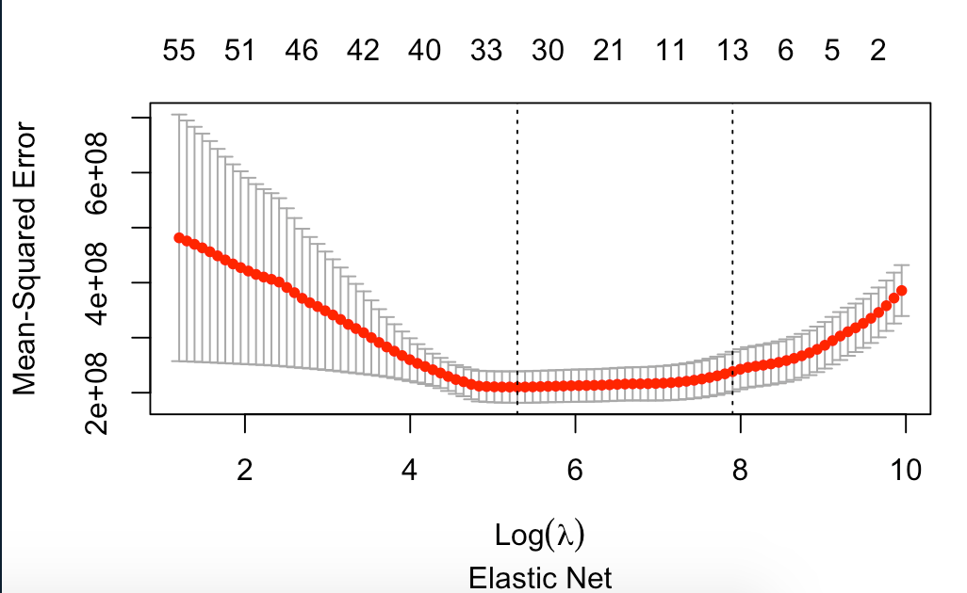
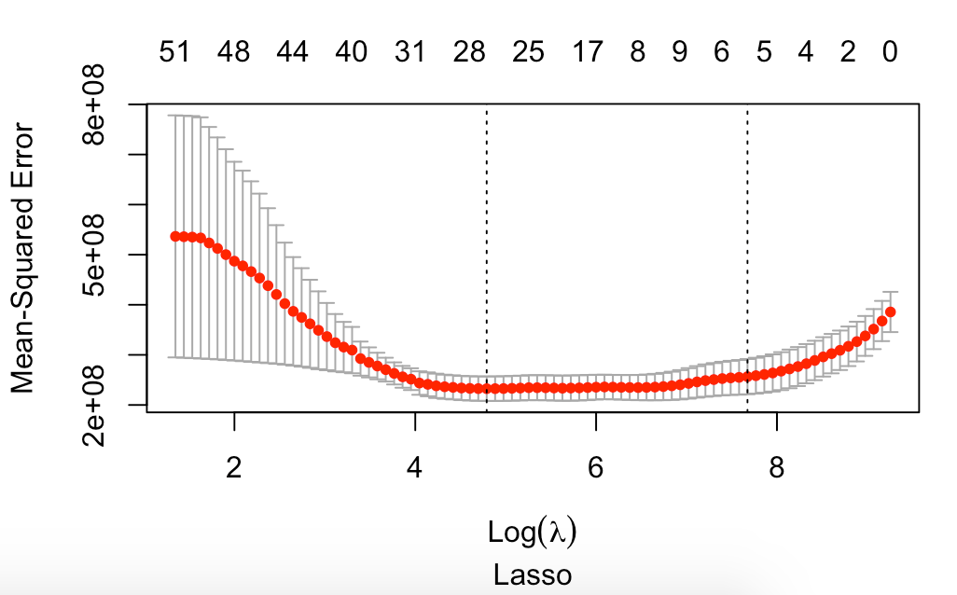
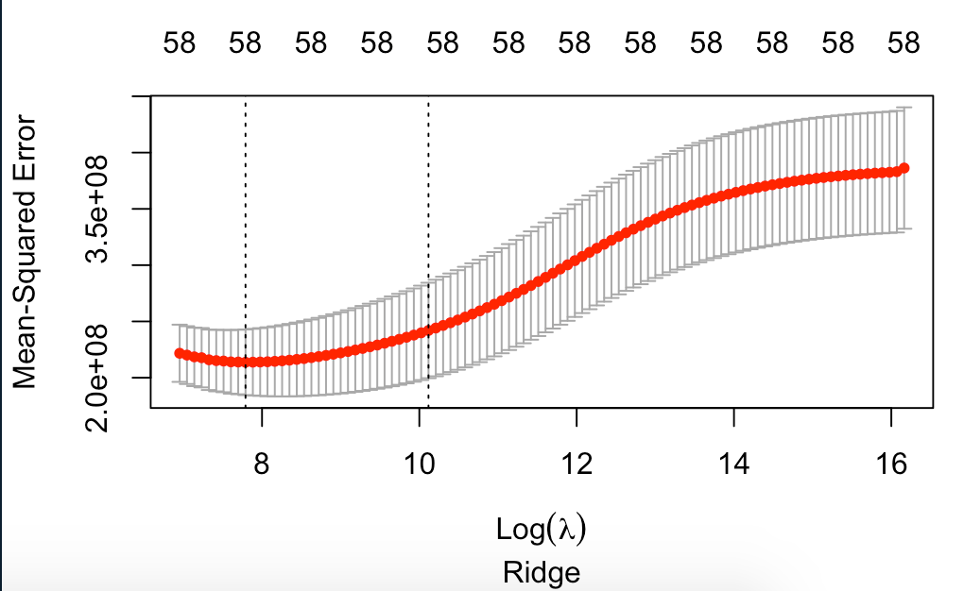
10-fold cv curves
Notes:
Explain the lowest point and one sd from it

Slide 5
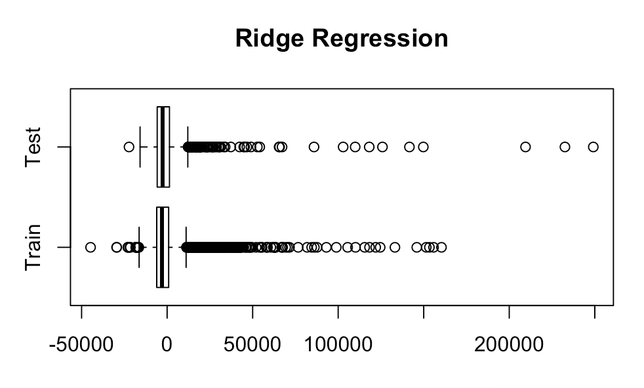
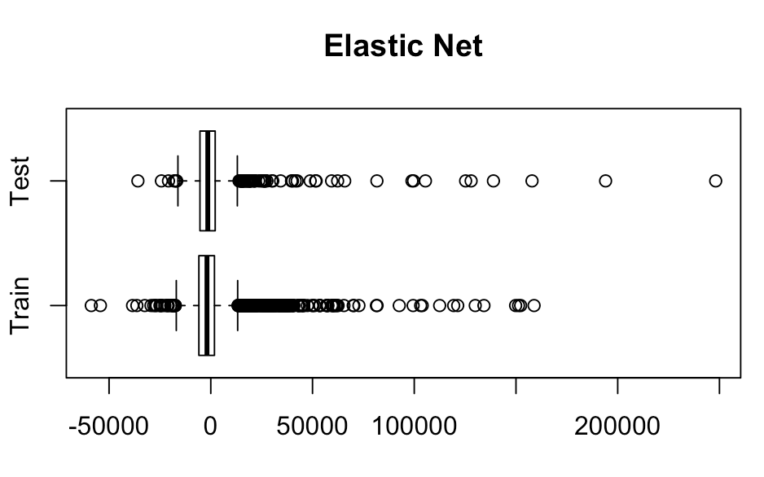
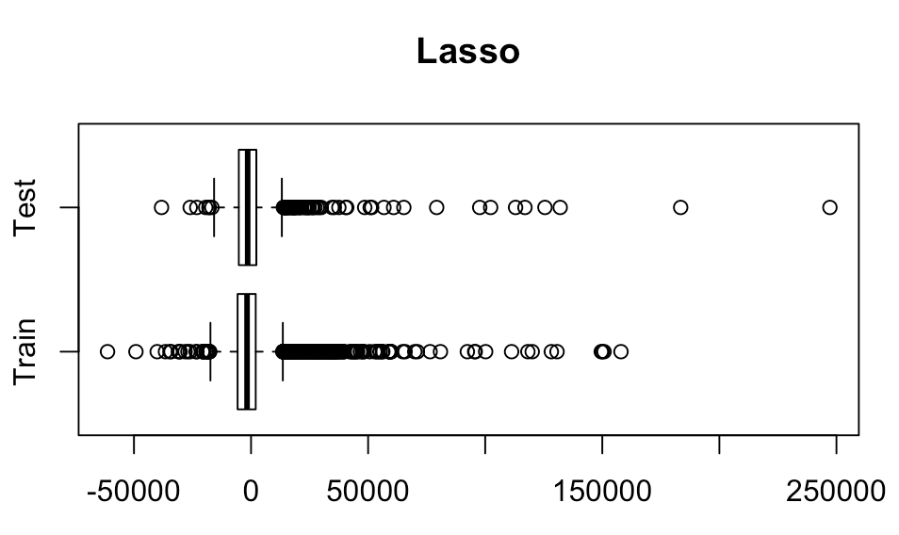
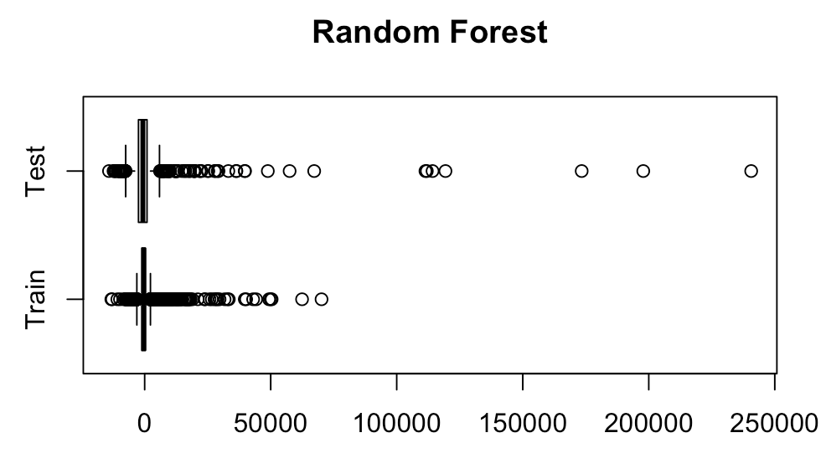
Residuals Boxplots
Notes:
Distribution of the residual: heavily skewed. A lot of outliers

Slide 6
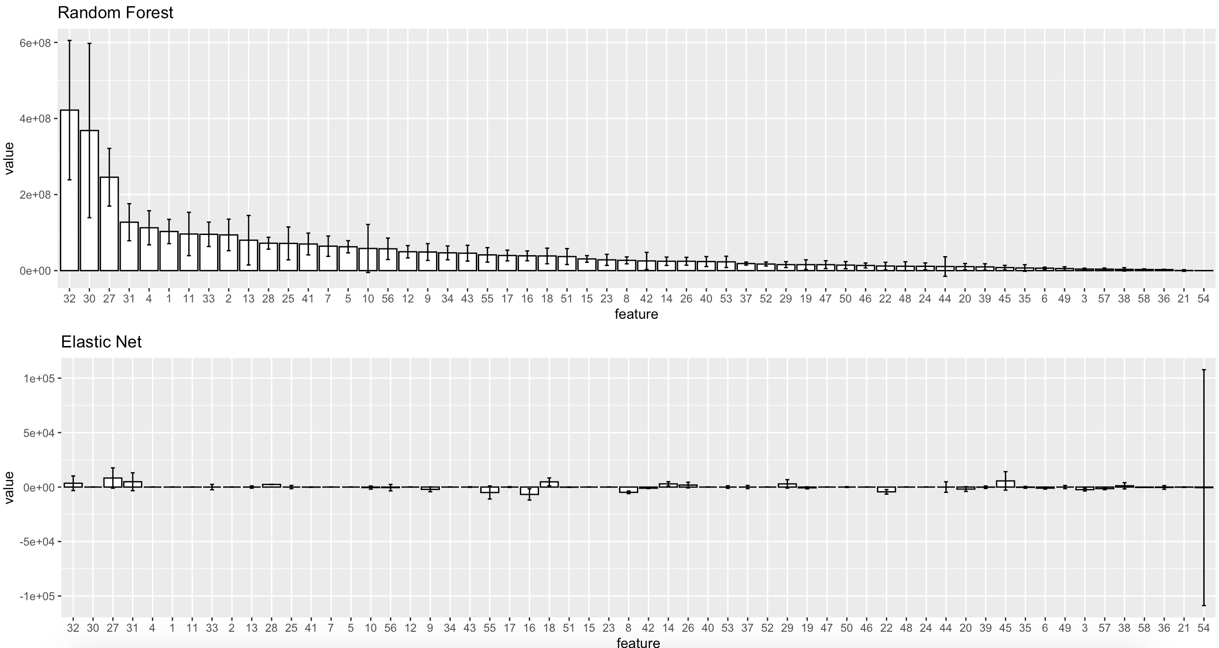
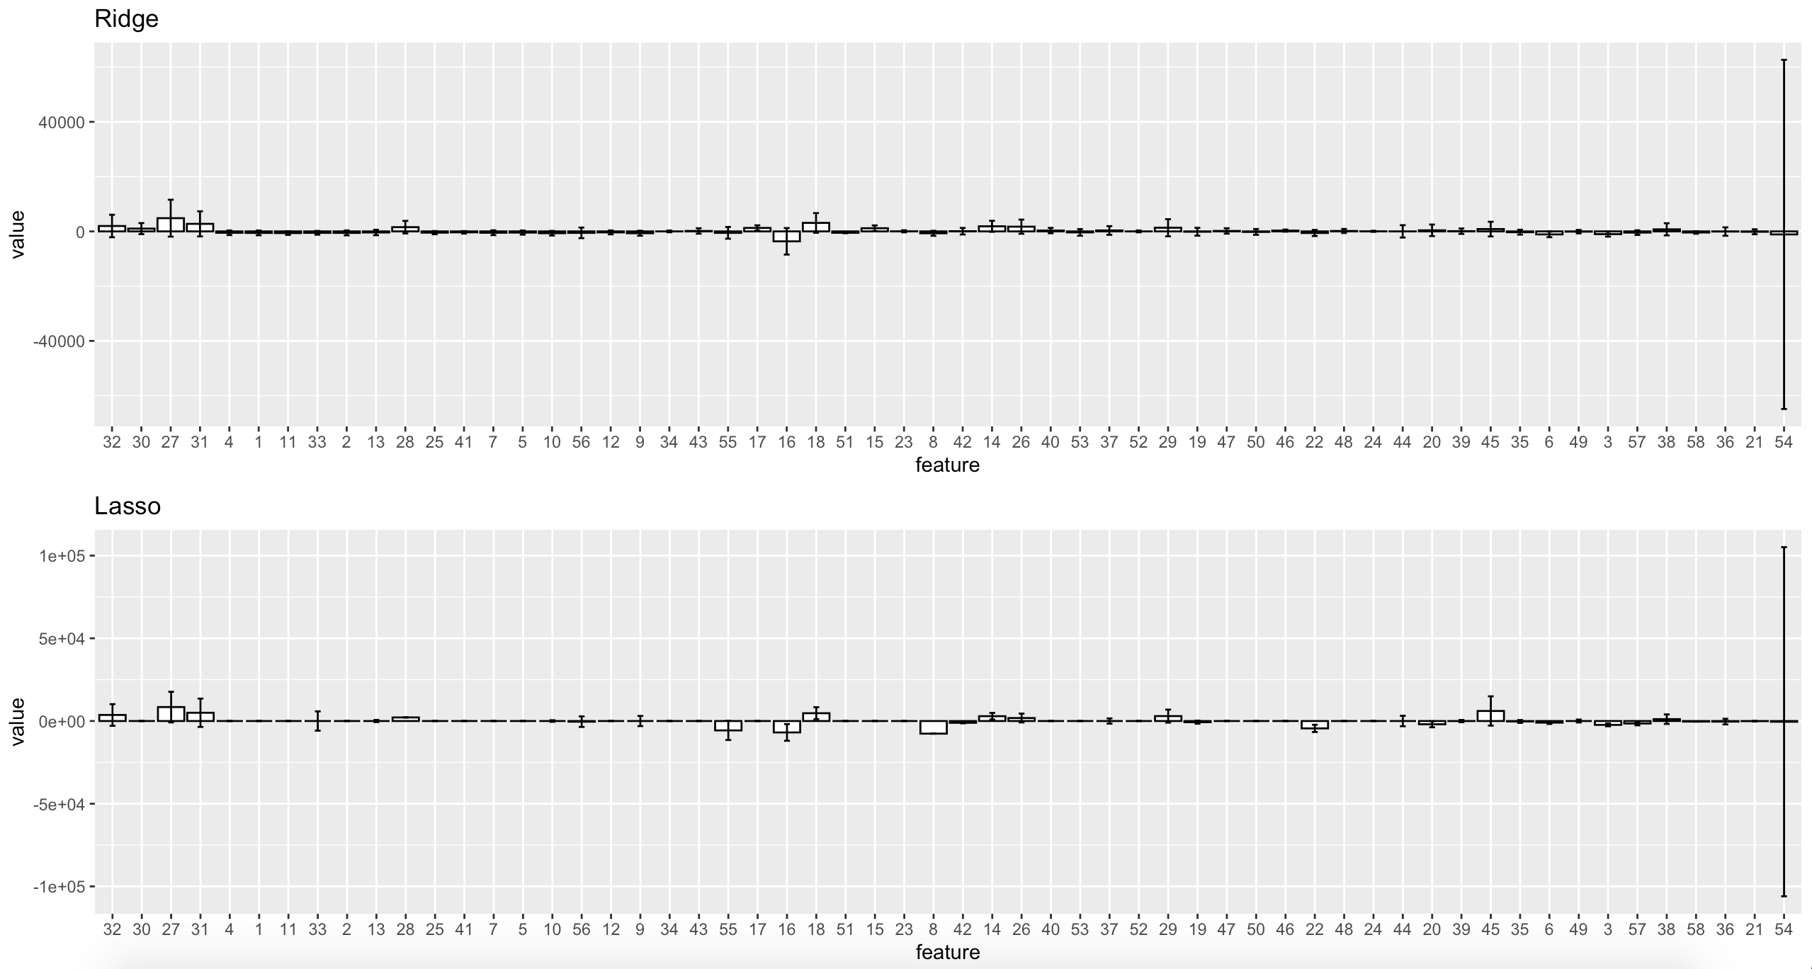
Bar-plots with bootstrapped error bars
Notes:
Ran the loop 5 times. Still too much variability for en, ls, rd. don’t see a consistent story

Slide 7
Summary
Performance:
- Lots of outliers and missing data => heavily skewed distribution
With computational limitation, there is variability in R-square. However, Random Forest performs best out of 4 because it adds randomness into the data and reduces the strong correlations between the predictors
Bootstrapped error bars shows a huge sign of variability in the strength of each predictor from method to method. They do not tell a consistent story.
Pick RF and work on reducing the correlations, increasing computational capability for a better result.
Time elapsed (loop run 5 times)
Models | Time
Random Forest | 30.097 secs
Elastic Net | 0.588 secs
Ridge Regression | 0.386 secs
Lasso | 0.456 secs
Using 5 bootstrapping samples | Total: 3.311 mins
Notes:
Too much variability for en, ls, rd

